Slide 1
Digital Circuit Experiment Integrated Synchronous Counter
Lecture 8
Rencan Nie（聂仁灿）

Slide 2
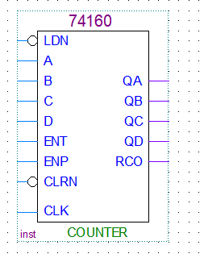
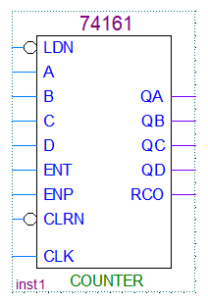
Theoretical Basis
Integrated Synchronous Counter
74LS160 and 74LS161
74LS160 is a integrated asynchronous counter with decimal modulus, whereas 74LS161 with hexadecimal modulus
Parallel Output Ports: QD QC QB QA (4-bits)
Parallel Input Ports: D C B A (4-bits)
CLK Port:
The clock of a counter (active high going edge)
Count Enable Ports:
ENP=ENT=1(active high going edge)
Clear Port:
CLRN=0 (active low), QD QC QB QA =0000
Load Data Port:
LDN=0 (active low), QD QC QB QA =D C B A
Terminal Count Port: RCO
Decimal modulus:
0~9
hexadecimal modulus:
0~15

Slide 3
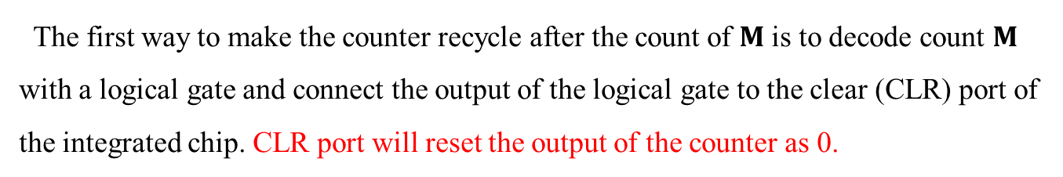
Theoretical Basis
Counter design
Partial Decoding: CLR based method
The first way to make the counter recycle after the count of $M$ is to decode count $M$ with a logical gate and connect the output of the logical gate to the clear (CLR) port of the integrated chip. CLR port will reset the output of the counter as 0.
CP | Q₃Q₂Q₁Q₀
0 | 0 0 0 0
1 | 0 0 0 1
2 | 0 0 1 0
3 | 0 0 1 1
4 | 0 1 0 0
5 | 0 1 0 1
6 | 0 1 1 0
7 | 0 1 1 1
8 | 1 0 0 0
9 | 1 0 0 1
10 | 1 0 1 0
11 | 1 0 1 1
12 | 1 1 0 0
13 | 1 1 0 1
14 | 1 1 1 0
15 | 1 1 1 1
0：0000
1：0001
2：0010
3：0011
4：0100
5：0101
15：1111
6：0000
Recycle with M = 10 states
14：1110
7：0110
13：1101
12：1100
11：1011
10：1001
9：1001
8：1000
transient state

Slide 4
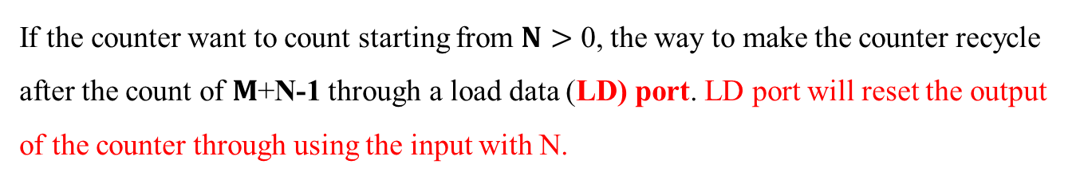

Theoretical Basis
Counter design
Partial Decoding: LD based method
If the counter want to count starting from $N>$ 0, the way to make the counter recycle after the count of $M$+N-1 through a load data (LD) port. LD port will reset the output of the counter through using the input with N.
CP | Q₃Q₂Q₁Q₀
0 | 0 0 0 0
1 | 0 0 0 1
2 | 0 0 1 0
3 | 0 0 1 1
4 | 0 1 0 0
5 | 0 1 0 1
6 | 0 1 1 0
7 | 0 1 1 1
8 | 1 0 0 0
9 | 1 0 0 1
10 | 1 0 1 0
11 | 1 0 1 1
12 | 1 1 0 0
13 | 1 1 0 1
14 | 1 1 1 0
15 | 1 1 1 1
$$N=3$$
0：0000
1：0001
2：0010
3：0011
4：0100
5：0101
15：1111
Recycle with M =10 states
6：0000
14：1110
Counting N=3 through 12
7：0110
13：1101
12：1100
11：1011
10：1001
9：1001
8：1000

Slide 5
Theoretical Basis
Examples
CLR based method
Example 1: Pls design 9 modulus synchronous counter using 74LS160, employing CLR based method
Step 1: give the state transition diagram
CP | Q₃Q₂Q₁Q₀
0 | 0 0 0 0
1 | 0 0 0 1
2 | 0 0 1 0
3 | 0 0 1 1
4 | 0 1 0 0
5 | 0 1 0 1
6 | 0 1 1 0
7 | 0 1 1 1
8 | 1 0 0 0
9 | 1 0 0 1
10 | 1 0 1 0
0：0000
1：0001
2：0010
3：0011
4：0100
Recycle with M = 9 states
5：0101
9：1001
8：1010
7：0110
6：0000
transient state

Slide 6
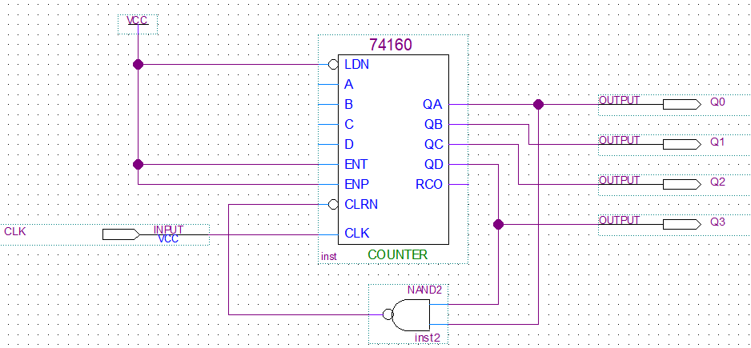
Theoretical Basis
Examples
CLR based method
Example 1: Pls design 9 modulus synchronous counter using 74LS160, employing CLR based method
Step 2: design the circuit expected
The logical gate is designed based on the transient state
The logical gate is connected with CLRN port
CP | Q₃Q₂Q₁Q₀
0 | 0 0 0 0
1 | 0 0 0 1
2 | 0 0 1 0
3 | 0 0 1 1
4 | 0 1 0 0
5 | 0 1 0 1
6 | 0 1 1 0
7 | 0 1 1 1
8 | 1 0 0 0
9 | 1 0 0 1
10 | 1 0 1 0

Slide 7
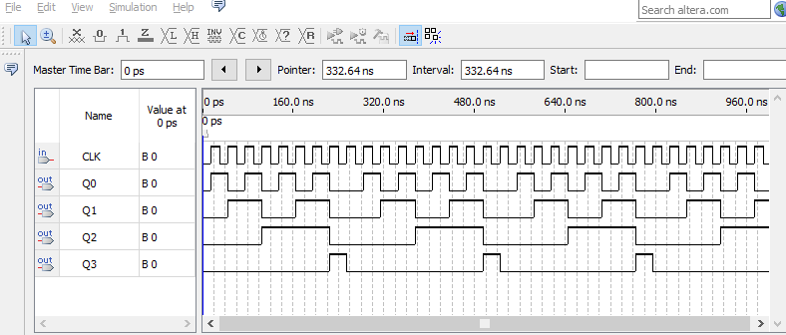
Theoretical Basis
Examples
CLR based method
Example 1: Pls design 9 modulus synchronous counter using 74LS160, employing CLR based method
Step 3: Simulation results
CP | Q₃Q₂Q₁Q₀
0 | 0 0 0 0
1 | 0 0 0 1
2 | 0 0 1 0
3 | 0 0 1 1
4 | 0 1 0 0
5 | 0 1 0 1
6 | 0 1 1 0
7 | 0 1 1 1
8 | 1 0 0 0
9 | 1 0 0 1
10 | 1 0 1 0
8

Slide 8
Theoretical Basis
Examples
CLR based method
Example 2: Pls design 10 modulus synchronous counter using 74LS161, employing CLR based method
Step 1: give the state transition diagram
CP | Q₃Q₂Q₁Q₀
0 | 0 0 0 0
1 | 0 0 0 1
2 | 0 0 1 0
3 | 0 0 1 1
4 | 0 1 0 0
5 | 0 1 0 1
6 | 0 1 1 0
7 | 0 1 1 1
8 | 1 0 0 0
9 | 1 0 0 1
10 | 1 0 1 0
11 | 1 0 1 1
12 | 1 1 0 0
13 | 1 1 0 1
14 | 1 1 1 0
15 | 1 1 1 1
0：0000
1：0001
2：0010
3：0011
4：0100
5：0101
6：0000
Recycle with M = 10 states
7：0110
10：1001
9：1001
8：1000
transient state

Slide 9
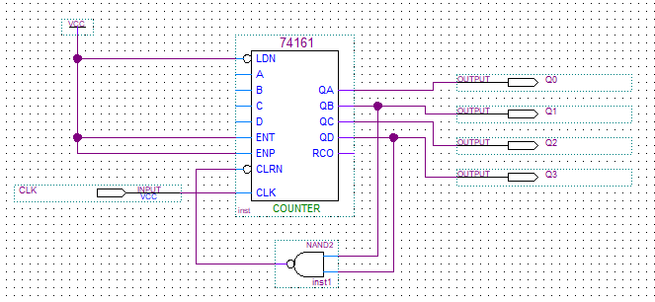
Theoretical Basis
Examples
CLR based method
Example 2: Pls design 10 modulus synchronous counter using 74LS161, employing CLR based method
Step 2: design the circuit expected
The logical gate is designed based on the transient state
The logical gate is connected with CLRN port
CP | Q₃Q₂Q₁Q₀
0 | 0 0 0 0
1 | 0 0 0 1
2 | 0 0 1 0
3 | 0 0 1 1
4 | 0 1 0 0
5 | 0 1 0 1
6 | 0 1 1 0
7 | 0 1 1 1
8 | 1 0 0 0
9 | 1 0 0 1
10 | 1 0 1 0
11 | 1 0 1 1
12 | 1 1 0 0
13 | 1 1 0 1
14 | 1 1 1 0
15 | 1 1 1 1

Slide 10
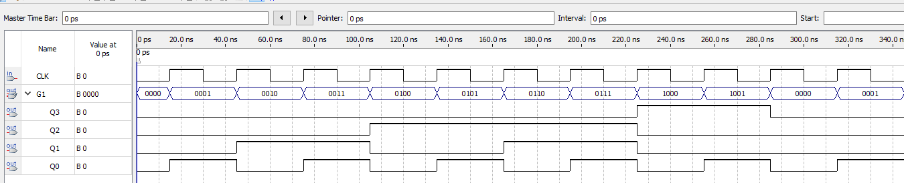
Theoretical Basis
Examples
CLR based method
Example 2: Pls design 9 modulus synchronous counter using 74LS161, employing CLR based method
Step 3: Simulation results
CP | Q₃Q₂Q₁Q₀
0 | 0 0 0 0
1 | 0 0 0 1
2 | 0 0 1 0
3 | 0 0 1 1
4 | 0 1 0 0
5 | 0 1 0 1
6 | 0 1 1 0
7 | 0 1 1 1
8 | 1 0 0 0
9 | 1 0 0 1
10 | 1 0 1 0
11 | 1 0 1 1
12 | 1 1 0 0
13 | 1 1 0 1
14 | 1 1 1 0
15 | 1 1 1 1
9

Slide 11
Theoretical Basis
Examples
LD based method
Example 3: Pls design 7 (starting from 3) modulus synchronous counter using 74LS160, employing LD based method
Step 1: give the state transition diagram
CP | Q₃Q₂Q₁Q₀
0 | 0 0 0 0
1 | 0 0 0 1
2 | 0 0 1 0
3 | 0 0 1 1
4 | 0 1 0 0
5 | 0 1 0 1
6 | 0 1 1 0
7 | 0 1 1 1
8 | 1 0 0 0
9 | 1 0 0 1
10 | 1 0 1 0
3：0011
4：0100
5：0101
Recycle with M = 7 states
9：1001
8：1010
7：0110
6：0000

Slide 12
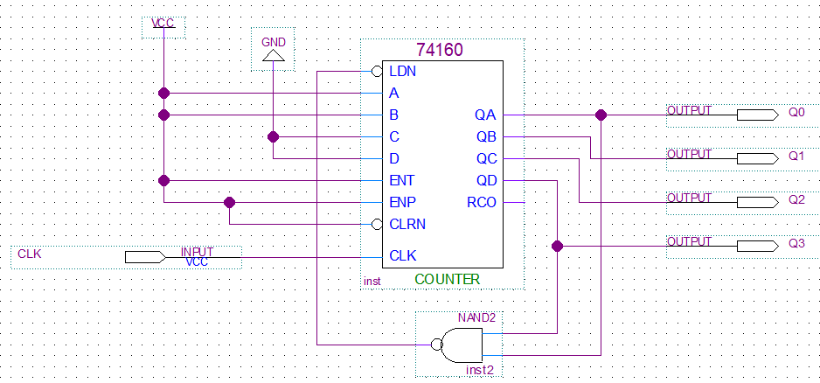
Theoretical Basis
Examples
LD based method
Example 3: Pls design 7 (starting from 3) modulus synchronous counter using 74LS160, employing LD based method
Step 2: design the circuit expected
The logical gate is designed based on the transient state
The logical gate is connected with CLRN port
CP | Q₃Q₂Q₁Q₀
0 | 0 0 0 0
1 | 0 0 0 1
2 | 0 0 1 0
3 | 0 0 1 1
4 | 0 1 0 0
5 | 0 1 0 1
6 | 0 1 1 0
7 | 0 1 1 1
8 | 1 0 0 0
9 | 1 0 0 1
10 | 1 0 1 0

Slide 13
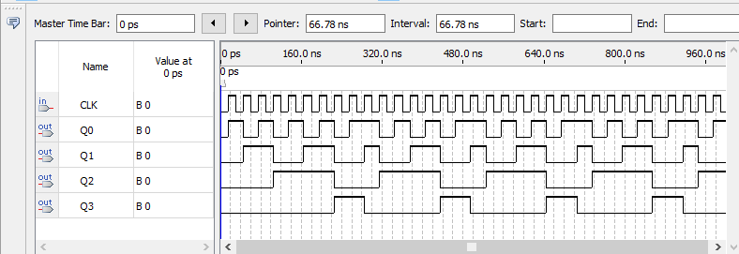
Theoretical Basis
Examples
LD based method
Example 3: Pls design 6 (starting from 3) modulus synchronous counter using 74LS160, employing LD based method
Step 3: Simulation results
CP | Q₃Q₂Q₁Q₀
0 | 0 0 0 0
1 | 0 0 0 1
2 | 0 0 1 0
3 | 0 0 1 1
4 | 0 1 0 0
5 | 0 1 0 1
6 | 0 1 1 0
7 | 0 1 1 1
8 | 1 0 0 0
9 | 1 0 0 1
10 | 1 0 1 0
3
9

Slide 14
Theoretical Basis
Examples
LD based method
Example 4: Pls design 12 (starting from 3) modulus synchronous counter using 74LS161, employing LD based method
Step 1: give the state transition diagram
CP | Q₃Q₂Q₁Q₀
0 | 0 0 0 0
1 | 0 0 0 1
2 | 0 0 1 0
3 | 0 0 1 1
4 | 0 1 0 0
5 | 0 1 0 1
6 | 0 1 1 0
7 | 0 1 1 1
8 | 1 0 0 0
9 | 1 0 0 1
10 | 1 0 1 0
11 | 1 0 1 1
12 | 1 1 0 0
13 | 1 1 0 1
14 | 1 1 1 0
15 | 1 1 1 1
3：0011
4：0100
5：0101
6：0110
7：0111
8：1000
9：1001
Recycle with M = 12 states
10：1010
14：1110
13：1101
12：1100
11：1011

Slide 15
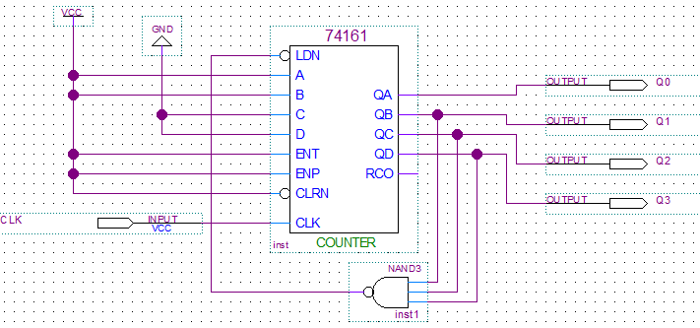
Theoretical Basis
Examples
LD based method
Example 4: Pls design 12 (starting from 3) modulus synchronous counter using 74LS161, employing LD based method
Step 2: design the circuit expected
The logical gate is designed based on the transient state
The logical gate is connected with LDN port
CP | Q₃Q₂Q₁Q₀
0 | 0 0 0 0
1 | 0 0 0 1
2 | 0 0 1 0
3 | 0 0 1 1
4 | 0 1 0 0
5 | 0 1 0 1
6 | 0 1 1 0
7 | 0 1 1 1
8 | 1 0 0 0
9 | 1 0 0 1
10 | 1 0 1 0
11 | 1 0 1 1
12 | 1 1 0 0
13 | 1 1 0 1
14 | 1 1 1 0
15 | 1 1 1 1

Slide 16
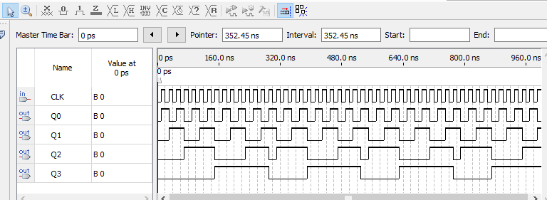
Theoretical Basis
Examples
LD based method
Example 4: Pls design 12 (starting from 3) modulus synchronous counter using 74LS161, employing LD based method
Step 3: Simulation results
CP | Q₃Q₂Q₁Q₀
0 | 0 0 0 0
1 | 0 0 0 1
2 | 0 0 1 0
3 | 0 0 1 1
4 | 0 1 0 0
5 | 0 1 0 1
6 | 0 1 1 0
7 | 0 1 1 1
8 | 1 0 0 0
9 | 1 0 0 1
10 | 1 0 1 0
11 | 1 0 1 1
12 | 1 1 0 0
13 | 1 1 0 1
14 | 1 1 1 0
15 | 1 1 1 1
3
14

Slide 17
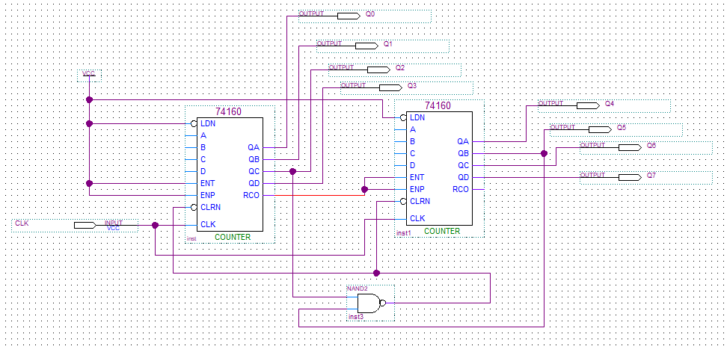
Theoretical Basis
Examples
Cascaded counters
Example 5: Pls design 24 modulus synchronous counter using 74LS160. Counting from 0 to 23
Tips: (Method 1)
A 74LS160 just has maximal modulus with 10
Two Cascaded counters with 74LS160 have maximal modulus with 10X10=100
When Q7Q6Q5Q4 Q3Q2Q1Q0 = 24 = 0010 0100, reset output as 0000 0000 through using CLRN

Slide 18
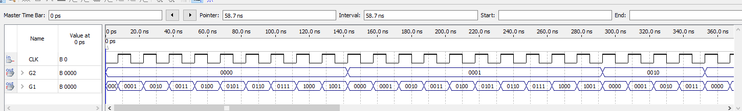
Theoretical Basis
Examples
Cascaded counters
Example 5: Pls design 24 modulus synchronous counter using 74LS160. Counting from 0 to 23
Tips: (Method 1)
A 74LS160 just has maximal modulus with 10
Two Cascaded counters with 74LS160 have maximal modulus with 10X10=100
When Q7Q6Q5Q4 Q3Q2Q1Q0 = 24 = 0010 0100, reset output as 0000 0000 through using CLRN

Slide 19
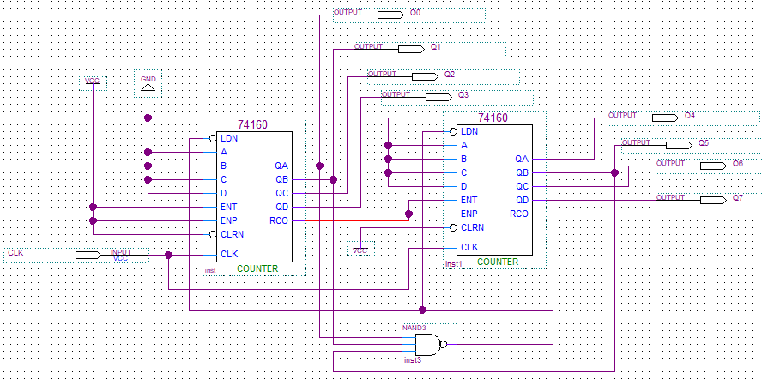
Theoretical Basis
Examples
Cascaded counters
Example 5: Pls design 24 modulus synchronous counter using 74LS160. Counting from 0 to 23
Tips: (Method 2)
A 74LS160 just has maximal modulus with 10
Two Cascaded counters with 74LS160 have maximal modulus with 10X10=100
When Q7Q6Q5Q4 Q3Q2Q1Q0 = 23 = 0010 0011, reset output as DCBA=0000 0000 through using LDN

Slide 20
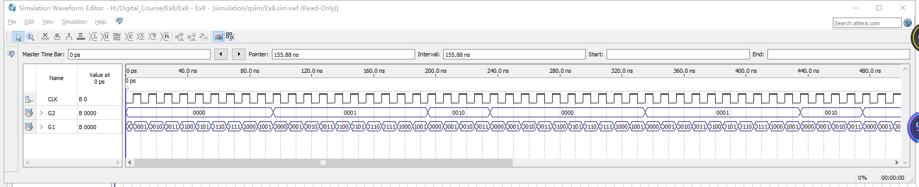
Theoretical Basis
Examples
Cascaded counters
Example 5: Pls design 24 modulus synchronous counter using 74LS160. Counting from 0 to 23
Tips: (Method 2)
A 74LS160 just has maximal modulus with 10
Two Cascaded counters with 74LS160 have maximal modulus with 10X10=100
When Q7Q6Q5Q4 Q3Q2Q1Q0 = 23 = 0010 0011, reset output as DCBA= 0000 0000 through using LDN

Slide 21
Theoretical Basis
Examples
Cascaded counters
Example 6: Pls design 120 modulus synchronous counter using 74LS161. Counting from 0 to 119
Tips: A 74LS161 just has maximal modulus with 16
According to 120=10*12, we can design two counters with 10 and 12 modulus, respectively.
Cascade these two counter through the way of serial carry
Designing a counter with 10 or 12 modulus, we can employ not only the CLR based method but also the LD based method. Where we leverage the CLR based method to design a counter with 10 modulus , whereas another counter with 12 modulus is constructed using the LD based method.

Slide 22
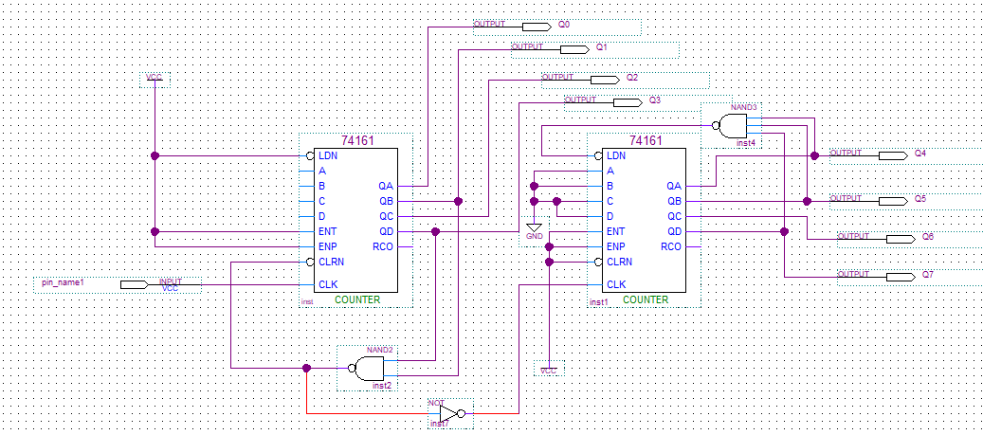
Theoretical Basis
Examples
Cascaded counters
Example 6: Pls design 120 modulus synchronous counter using 74LS161. Counting from 0 to 119
Tips: According to 120=10*12, we can design two counters with 10 and 12 modulus, respectively.
Cascade these two counter through the way of serial carry

Slide 23
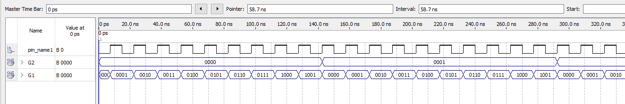
Theoretical Basis
Examples
Cascaded counters
Example 6: Pls design 120 modulus synchronous counter using 74LS161. Counting from 0 to 119
Tips: According to 120=10*12, we can design two counters with 10 and 12 modulus, respectively.
Cascade these two counter through the way of serial carry

Slide 24
Theoretical Basis
Examples
Cascaded counters
Example 7: Pls design 60 modulus synchronous counter using 74LS160. Counting from 0 to 59
Tips:
A 74LS160 just has maximal modulus with 10
According to 60=10*6, we can design a counter with 6.
Cascade these two counters with 10 and 6 through the way of simultaneous carry
Designing a counter with 6 modulus, we can employ not only the CLR based method but also the LD based method. Where we leverage the CLR based method to design a counter with 6 modulus .

Slide 25
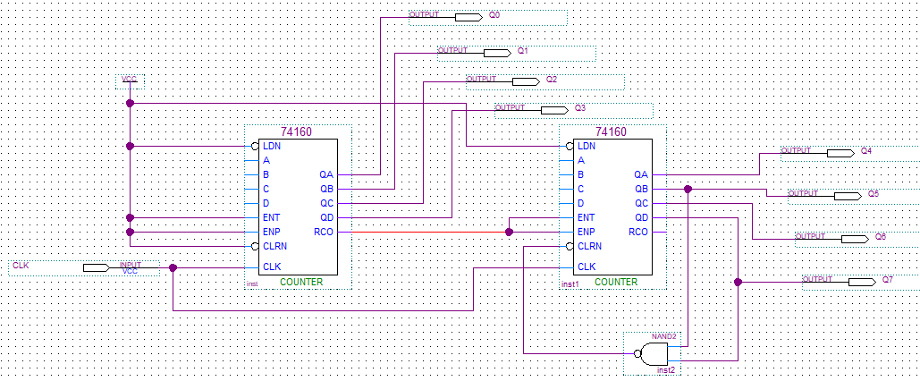
Theoretical Basis
Examples
Cascaded counters
Example 7: Pls design 60 modulus synchronous counter using 74LS160. Counting from 0 to 59
Tips:
According to 60=10*6, we can design a counter with 6 modulus.
Cascade these two counters with 10 and 6（1010） through the way of simultaneous carry

Slide 26
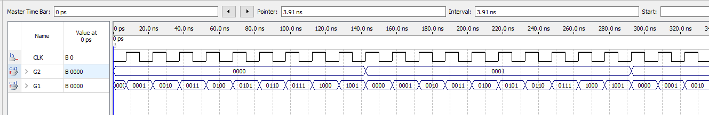
Theoretical Basis
Examples
Cascaded counters
Example 7: Pls design 120 modulus synchronous counter using 74LS160. Counting from 0 to 59
Tips:
According to 120=10*6, we can design two counters with 6 modulus.
Cascade these two counters with 10 and 6 through the way of simultaneous carry

Slide 27
Experiments
Experimental purposes
Based on the CLR based method, understand how to design and test a M-modules synchronous counter, through integrated chips.
Based on the LD based method, understand how to design and test a M-modules synchronous counter, through integrated chips.
Based on the multi modulus cascaded-based method, understand how to design and test a M-modules synchronous counter, through integrated chips.

Slide 28
Experimental Contents
Task 1. Design and test a 6 modules synchronous counter by 74LS160
Step 1: Design a 6 modules synchronous counter by 74LS160, through using the CLR based method
Pls consult the Example 1!!!
Step 2: input the counting pulses to the designed counter, then test and record the waves for different output bits with Q₃~Q_{0.}
Note that:
Count from 0 to 5.
There is a transient state with 6 for the CLR based method.

Slide 29
Experimental Contents
Task 2. Design and test a 11 modules synchronous counter by 74LS161
Step 1: Design a 11 modules synchronous counter by 74LS161, through using the LD based method
Pls consult the Example 4!!!
Step 2: input the counting pulses to the designed counter, then test and record the waves for different output bits with Q₃~Q_{0.}
Note that:
Count from 0 to 10.
There is a last state with 10 for the LD based method.

Slide 30
Experimental Contents
Task 3. Design and test a 37 modules synchronous counter by 74LS160
Step 1: Design a 37 modulus synchronous counter by 74LS160, through using the total CLR based method.
Pls consult the Method 1 of Example 5!!!
Step 2: input the counting pulses to the designed counter, then test and record the waves for different output bits with Q₇~Q_{0.}
Tips: (Method 1)
A 74LS160 just has maximal modulus with 10
Two Cascaded counters with 74LS160 have maximal modulus with 10X10=100
Count from 0 to 36, there is a transient state with 37 for the CLR based method.
When Q7Q6Q5Q4 Q3Q2Q1Q0 = 37 = 0011 0111, reset output as 0000 0000 through using CLRN

Slide 31
Experimental Contents
Task 4. Design and test a 80 modules synchronous counter by 74LS161
Step 1: Design a 80 modulus synchronous counter by 74LS161, through using the counters cascaded based method.
Pls consult the Example 7!!!
Step 2: input the counting pulses to the designed counter, then test and record the waves for different output bits with Q₇~Q_{0.}
Tips:
A 74LS161 just has maximal modulus with 16.
According to 80=16*5, we need to design a counter with 5, through using the CLR based method.
Cascade these two counters with 16 and 5 through the way of simultaneous carry

Slide 32
Thanks

